Slide 1
Business Connectivity Services
Notes:
Microsoft first introduced the concept of the Business Data Catalog (BDC) in SharePoint 2007 to consume data from external sources. In SharePoint 2010 Microsoft improved on this platform by adding the ability to read/write data to these external systems as well as expand on the available data sources by adding a new concept: the .NET Connector. In this module you’ll learn how to use SharePoint Designer 2010 to integrate your SharePoint environment with external Line of Business Data to create robust business solutions.

Slide 2
Agenda
Overview and Architecture of Business Connectivity Services (BCS)
External Content Types (ECT)
External Lists
BCS Security
Working with External Data Directly from Outlook and Word
Creating .NET Assembly Connectors

Slide 3
Challenges With Back End Data: End Users
Multiple user interfaces
External systems can be difficult to use
Can't work with the data when and where I want to
Can’t easily search for business data
Need to involve IT to service my requests for data access
Notes:
SAP, Siebel, Dynamics CRM, databases, web services, other external sources. Need to learn how to work with external data. Can’t do it from mobile phone or browser. No self service. Very dependent on IT.

Slide 4
Challenges With Back End Data: IT Professionals / Administrators
Islands of business data
Overhead for IT to service all user requests
Manage security, auditing, connectivity
One off projects for connecting to external systems
Notes:
Everyone is creating their own solution. Hard for IT to manage all one off projects.

Slide 5
Business Connectivity Services
Bring data from external systems into SharePoint and Office, interact with it, reuse it, and empower end users to gain insight into the underlying data in a reusable way.
Extend the reach of Enterprise Data
Centrally manage reusable connections
Easily create custom solutions
Notes:
BCS is a set of out-of-box features, services and tools that streamline the creation of SharePoint Solutions with deep integration of External Data and Services. Power users, IT, Devs can create no code solutions using BCS.
The basics of ECT store and BDC runtime are baked into the SPF platform.
Why BCS?
Integrate other Line of Business application systems with SharePoint sites.
Search for data in other systems via the SharePoint Search service.
Save the time, cost, and monotony of writing yet another data layer!

Slide 6
BCS Terminology
Business Connectivity Services: All up
Business Data Connectivity (BDC): plumbing, runtime, connectivity
External Data: Target systems (ie: LOB’s)
External Content Type (ECT): Definition of external data
Model: XML file (Application Definition)
External List: Newest type of SP list
Notes:
BCS: Umbrella term – presentation, connectivity, tools in SharePoint and Office.
BDC: Object model, plumbing pieces (used to be Business Data Catalog).
External System: Line of Business Apps.
ECT: similar to entity in SP 2007. Objects when they come into SharePoint and Office.
Model: what used to be AppDef file. Collection of external content types.
External List: Way to expose LOB data in SharePoint.

Slide 7





BCS Components
Office Applications
BDC Client
Design Tools
SharePoint
Dev Platform
Business Intelligence
Enterprise Content Management
Collaboration Social
Enterprise Search
SharePoint Designer
External Lists
Visual Studio
External Content Type Repository
Business Data Connectivity
Database
Web Service
.NET Assembly Connector
Notes:
BCS connects to external sources to bring data in SharePoint and Office. Stores and secures ECTs – core building block for BCS. ECTs also define the object will behave in Office. External Lists bring in data into SharePoint as native first citizen data. Work with data as you work with other SharePoint lists.
Bring data in Office Apps – Outlook, Word, InfoPath and SharePoint Workspace. SPD and Visual Studio are the tools to design ECTs and InfoPath forms.
Visual Studio – more advanced scenarios to create reusable ECT and custom connectivity logic.
WCF connector to cloud based services with WCF end points or to web services.
.NET Assembly Connector allows you to build a .NET assembly that gathers data from multiple sources and then use the .NET Assembly Connector to connect to SharePoint and Office.

Slide 8
BCS Architecture
Office Client
SharePoint Server 2010
External Business Parts
SharePoint Site
Custom Code
VSTO
Package
External
List
Office Integration
Search, Workflow, Web Parts
Business Connectivity Services
Secure Store Service (SSS)
Business Connectivity Services
BDC Client Runtime
Cache
External Content Types (ECT)
BDC Server Runtime
SQL
Web Service
Custom
.NET Assembly Connector
External Data
Notes:
BDC stores and secures ECTs and related objects in metadata store. BDC runtime uses data in BDC metadata store to understand how to interact with the backend systems. BDC is a service application and can be enabled from central admin. BDC client runtime connects directly to the backend source. Client data cache accessible through SP workspace.
Business Connectivity Services is composed of many pieces:
Office Client – By connecting to SharePoint, Office clients can consume data from the external systems.
SharePoint Server – SharePoint houses the external content types (ECTs) which is the backbone of the entire system.
External Data – this is the source of where the data is coming from.

Slide 9
Agenda
Overview and Architecture of Business Connectivity Services (BCS)
External Content Types (ECT)
External Lists
BCS Security
Working with External Data Directly from Outlook and Word
Creating .NET Assembly Connectors

Slide 10



Solution Types
Custom connectivity for data aggregation, transformation, security, etc.
Use custom code to integrate data into any Office app
Business logic in forms
Create reusable components (UI parts, ECTs, actions)
Customize
InfoPath forms
Workflow
Web Part Pages
Outlook task pane and ribbon
Out-of-box
Surface data in External Lists
Connect those lists to Outlook, SharePoint Workspace
External Data Columns
Simple
Intermediate
Advanced
NO CODE*
CODE
SharePoint Designer 2010
SharePoint SDK
Visual
Studio 2010
Power User
Developer
Advanced Developer
Notes:
No code – power users using SPD and using samples from SDK, using XML, to modify how the data would be presented in Outlook.
Create solutions in code and make the components available to the power users.
Simple and Intermediate – SPD. Intermediate needs some XML as well.
Advanced solution – Create reusable components that can later be used by power users in SharePoint Designer.

Slide 11
External Content Types
Similar to traditional SharePoint content types
Describes data that lives outside of SharePoint
Contains operations that define specific actions
Insert
Update
Delete
ReadList
ReadOne
Created using SPD2010 / Visual Studio 2010

Slide 12
External Lists in SharePoint
Expose external data as a native SharePoint list
Full CRUD capability
Familiar UI and navigation
Sort, Filter, Group
Programmatic access via SPList OM
Profile page available for each item in the list
Form
Auto-generated OOTB
Upsize to InfoPath
Offline-able
Limitations
No alerts, versions, event receivers, workflows, etc.
Notes:
Data in External List is stored in external system and not in SharePoint.

Slide 13
Surfacing External Data
External Data Columns
Add data from external content types to standard SharePoint lists
Can be made available as Content Controls in Word
Web Parts
Scenario: Use for Dashboard pages
External Data List
External Data Item
External Data Item Builder
External Data Related List
External Data Connectivity Filter
Chart Web Part
External Data Search
Integrate External Data into search results

Slide 14
DEMO
Modeling External Content Types

Slide 15
Agenda
Overview and Architecture of Business Connectivity Services (BCS)
External Content Types (ECT)
External Lists
BCS Security
Working with External Data Directly from Outlook and Word
Creating .NET Assembly Connectors

Slide 16
BCS Security Overview
Popular Authentication Options | WCF Service Connector | Database Connector | .NET Assembly Connector
SQL Auth | N/A | Yes | Code-Based
UserName & Password | Yes | Yes | Code Based
NTLM Pass through | Yes | Yes | Yes
Claims Token | Yes | No | Code Based
OpenID / LiveID | Code Based | No | Code Based

Slide 17











BCS Authentication (server)
SharePoint Server
Process Account
Modes:
PassThrough
(Uses logged-on user)
RevertToSelf
(Uses process account)
SSO Authentication
(Credentials, etc. from
Secure Store)
Application
Credentials Ticket
Delegation Token
Other
WebPart
Logged-on
user
VL
BDC Server
Runtime
Secure Store
Service
SAML
Token
Application
Delegated
Token
Credentials
Claims Aware
Service
Web 2.0
External System
Notes:
When accessing external data from a supported Office client application, two systems are involved: the client computer of the logged on user and the external system.
Outlook 2010 users typically use external data in Outlook items such as Contacts or Tasks. SharePoint Workspace 2010 users can take external lists offline and interact with them. Word 2010 users can insert external data into Word documents.
The Office Integration Client Runtime acts as a connector between Microsoft Business Connectivity Services running on the client and the supported Office applications.
If the external data is configured to use claims-based authentication, the client interacts with the Security Token Service on the SharePoint farm to get a claims token.
The BDC Client Runtime on client computers uses the data from the Business Data Connectivity service to connect to and execute operations on external systems for rich client access.
The Client Cache caches information from the Business Data Connectivity service and Secure Store Service that is needed to securely connect to external data. The cache is refreshed from the SharePoint farm to incorporate updated information.
The client Secure Store Service enables end users to configure their security credentials.
Microsoft Business Connectivity Services can pass credentials to databases and claims aware services.

Slide 18











Session Context
Thin Client
Office Client
SharePoint
Mgmt OM
Operation
Mode
BDC
Business Data Connectivity
Client Cache
Secure Store Service
Sync Agent
Secure Store Service
Direct from Client
Connection
External Data Sources

Slide 19
Authorization in BCS
Available Permissions:
Edit: create, delete, update metadata objects
Execute: call external system (read)
Set Permissions: give permissions to other users
Selectable In Clients: accessible to clients applications like entity picker
Notes:
The authorization in BCS has to be set so users can create ECTs using SharePoint Designer.
At least one user must be granted Set Permissions in order to manage security on the ETC.

Slide 20
Agenda
Overview and Architecture of Business Connectivity Services (BCS)
External Content Types (ECT)
External Lists
BCS Security
Working with External Data Directly from Outlook and Word
Creating .NET Assembly Connectors

Slide 21
Products & Features Used: SharePoint 2010
External Lists
Surface external data to users
Familiar UI (sort, filter, group, etc.)
Auto-generated forms
Option to upsize to InfoPath forms
Document Library with External Data Columns
Extend regular lists and document libraries with external data
A copy of the external data is added to the SharePoint list (manual refresh)
Workflow
Access external data within Workflows

Slide 22
Products and Features Used: Outlook 2010
External Lists in Outlook
Offline with automatic data sync with external system through BDC cache
Extended Outlook item schemas
Custom forms and views
Search across external data
Custom Ribbon Actions and TaskPanes
Office Business Parts (OBPs)
Via Declarative Customization

Slide 23
Products and Features Used: Word 2010
Read/Write access to External Data Columns from within Word
Via Quick Parts
Picking and resolving experience via content controls
Offline and online modes
Automatic update of External Data Columns when Word document is uploaded to the library
Self-contained offline solution

Slide 24
DEMO
Creating an End to End Solution

Slide 25
Agenda
Overview and Architecture of Business Connectivity Services (BCS)
External Content Types (ECT)
External Lists
BCS Security
Working with External Data Directly from Outlook and Word
Creating .NET Assembly Connectors

Slide 26
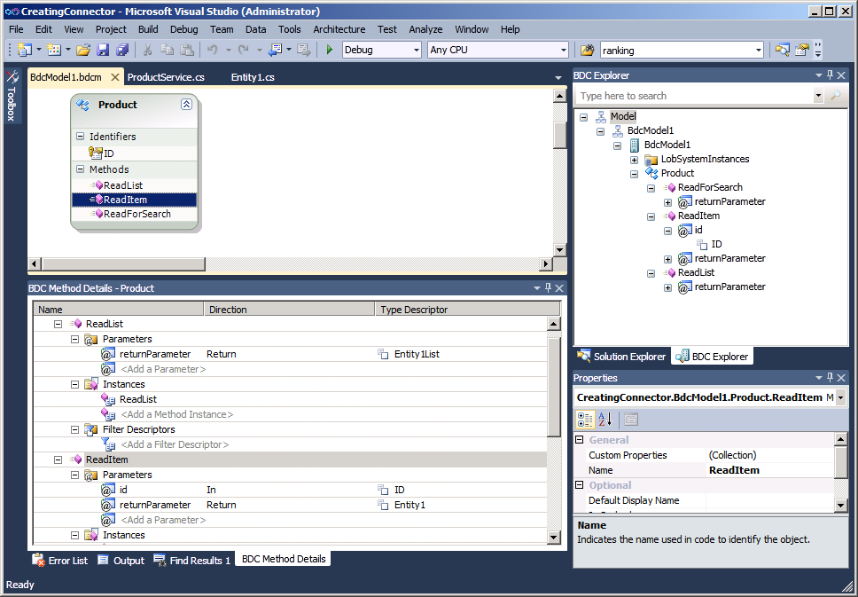
Visual Studio 2010 Support
The tool for creating .NET Assembly Connectors
Useful when need to implement custom logic in operations or connect to different types of data sources
Notes:
The Visual Studio 2010 Tools for SharePoint 2010 contain a project template for designing Business Data Connectivity models. It comes with a set of visual designers and code management that will let you author External Content Types.
Visual Studio 2010 BCS Designer allows you to develop, debug and deploy BDC models using the External System type .NET Assembly Connector. This type is used for:
Aggregation scenarios (across back-ends, across multiple calls to same backend, read from one back-end write to another).
Custom/Complex Data Transformations.
Custom Security (e.g. where SSO falls short).
Custom Business Logic/Rules needed outside the back-end (don’t have good example of this).
In addition Visual Studio 2010 BCS designer allows to import models created by SPD and customize them, package them and deploy them through Visual Studio.

Slide 27
Summary
Overview and Architecture of Business Connectivity Services (BCS)
External Content Types (ECT)
External Lists
BCS Security
Working with External Data Directly from Outlook and Word
Creating .NET Assembly Connectors

